Slide 1
Internet of Things
IoT Communications and Networking Technologies and Protocols
Professor: Dr.Siavash Khorsandi
Lecturer: Jaber Babaki
Amirkabir University of Technology
Fall 2020

Slide 2
Contents
Introduction
Physical and Link Layers Protocols (IoT Access Technologies)
Application Layer Protocols
Mostly adopted from Chapters 4, 5, and 6 of IoT Fundamentals: Networking Technologies, Protocols, and Use Cases for the Internet of Thing, Cisco press, 2017

Slide 3
Contents
Introduction
Physical and Link Layers Protocols (IoT Access Technologies)
Physical Layer Issues
Communication Technologies Criteria
Communication Technologies and Protocols
Short Range Access technologies (PHY and Link Layer Protocols)
Long Range Access technologies (PHY and Link Layer Protocols)
Network Layer Protocols (IP as the IoT Network Layer)
Transport Layer Protocols
Application Layer Protocols

Slide 4
Frequency Range
Radio
Signal carried in electromagnetic spectrum
Propagation environment effects:
Reflection
Obstruction by objects
Interference

Slide 5
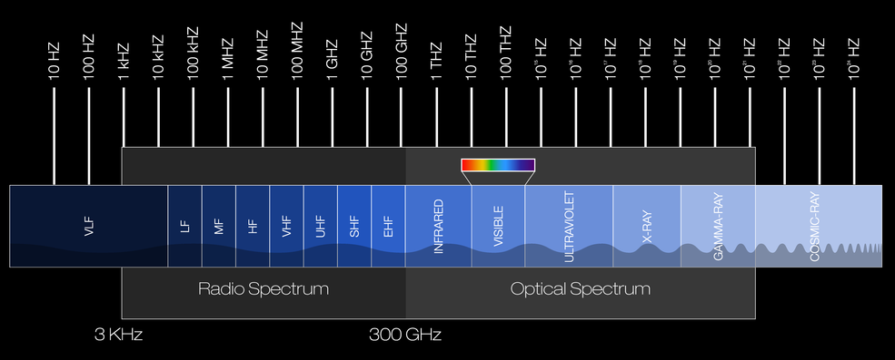
Frequency Range

Slide 6
Frequency Range
Radio frequency range
30 MHz to 30 GHz
Suitable for omnidirectional applications
Frequencies of 1 GHz and above are conventionally called microwave
Millimeter Wave
Frequencies of 30 GHz and above are designated .
Infrared frequency range
Roughly, 3x10^11 (300 GHz) to 2x10^14 (200 THz)
Useful in local point-to-point multipoint applications within confined areas

Slide 7
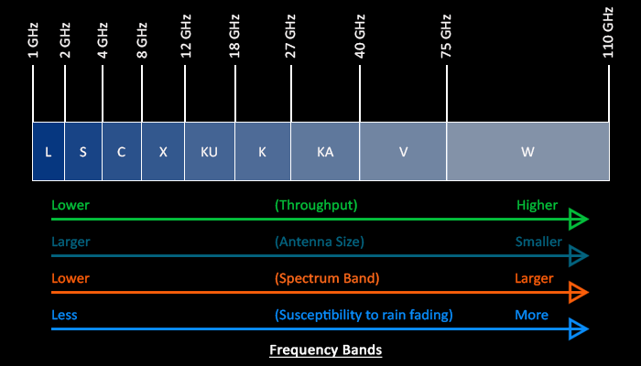
Frequency Range

Slide 8
Frequency Range
Most wireless applications reside in radio frequency between 30MHz to 30 GHz (VHF, UHF and SHF)
Why these frequencies?
They are not affected by earth curvature
Require only moderated size antennas
*Adopted from Wireless Communication by Goldsmith (Chapter2)

Slide 9
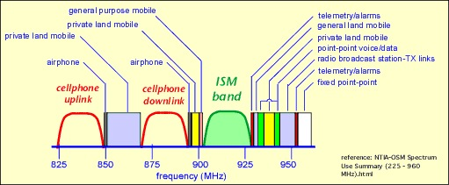
Example of ISM frequency allocation

Slide 10
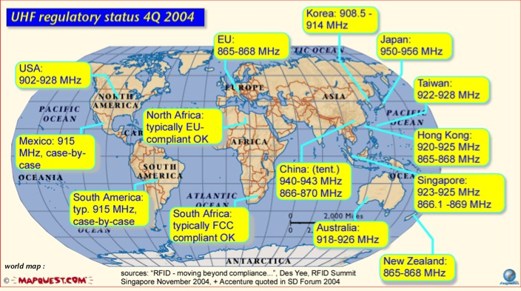
Example of ISM frequency allocation

Slide 11
What is the difference between channel & frequency & band in RF?
A frequency band, or band: is a range of frequencies with a specific least frequency and greatest frequency. Generally bands are used to describe some relevant range:
A radio is capable of operating within some band of frequencies; outside that band its performance will not meet specification or it will be incapable of tuning there.
The legal limits on transmissions are defined in terms of many bands; when people say "the 2.4 GHz band" they mean the ISM band that extends from 2.400 GHz to 2.500 GHz, which is purely a legal definition and has no technical significance other than that devices may be internally restricted to operate in those bounds.
When a signal is actually transmitted, we can talk about the band of that signal, that is, the range of frequencies which have significant/useful signal power on them.
Channel has two different meanings:
Usage of a band can be channelized, which means that the radios which transmit on it do not pick frequencies arbitrarily but stick to a certain step size (e.g. 10 KHz for CB radio, so frequencies like 27.105, 27.115, 27.125 MHz). This makes it easier for a receiver to match a transmitter, and allows more efficient use overall as there are no wasted narrow gaps between signals.
In communications theory, the channel is the medium that carries the signal. This is a different kind of word than the others because it's an abstraction that is not about frequency, but it is like the above in that to look at an RF channel you ignore everything outside of the frequency range that defines the channel.

Slide 12
Communication Technologies Criteria
Currently, the number of technologies (available or under development) connecting smart objects is quite extensive,
but you should expect consolidation, with certain protocols eventually winning out over others in the various IoT market segments.
Before reviewing some of these access technologies, it is important to talk about the criteria to use in evaluating them for various use cases and system solutions.
* IoT Fundamentals: Networking Technologies, Protocols, and Use Cases for the Internet of Thing, Cisco press, 2017

Slide 13
Communication Technologies Criteria
1- Range
2- Frequency Bands
3- Power Consumption
4- Topology
5- Constrained Devices
6- Constrained-Node Networks
* IoT Fundamentals: Networking Technologies, Protocols, and Use Cases for the Internet of Thing, Cisco press, 2017

Slide 14
Communication Technologies Criteria: 1-Range
Short range:
Tens of meters of maximum distance between two device
Example:
The classical wired example is a serial cable!
Wireless Examples: IEEE 802.15.1, Bluetooth and IEEE 802.15.7 Visible Light Communications (VLC).
Medium range:
Tens to hundreds of meters
Examples:
IEEE 802.11 Wi-Fi, IEEE 802.15.4, and 802.15.4g WPAN.
Wired technologies such as IEEE 802.3 Ethernet and IEEE 1901.2 Narrowband PLC
* IoT Fundamentals: Networking Technologies, Protocols, and Use Cases for the Internet of Thing, Cisco press, 2017
Notes:
Short range: The classical wired example is a serial cable. Wireless short-range technologies are often considered as an alternative to a serial cable, supporting tens of meters of maximum distance between two devices. Examples of short-range wireless technologies are IEEE 802.15.1 Bluetooth and IEEE 802.15.7 Visible Light Communications (VLC). These short-range communication methods are found in only a minority of IoT installations. In some cases, they are not mature enough for production deployment.
Medium range: This range is the main category of IoT access technologies. In the range of tens to hundreds of meters, many specifications and implementations are available. The maximum distance is generally less than 1 mile between two devices, although RF technologies do not have real maximum distances defined, as long as the radio signal is transmitted and received in the scope of the applicable specification. Examples of medium-range wireless technologies include IEEE 802.11 Wi-Fi, IEEE 802.15.4, and 802.15.4g WPAN. Wired technologies such as IEEE 802.3 Ethernet and IEEE 1901.2 Narrowband Power Line Communications (PLC) may also be classified as medium range, depending on their physical media characteristics.
Long range: Distances greater than 1 mile between two devices require long-range technologies. Wireless examples are cellular (2G, 3G, 4G)
and some applications of outdoor IEEE 802.11 Wi-Fi and Low-Power Wide-Area (LPWA) technologies. LPWA communications have the ability to communicate over a large area without consuming much power. These technologies are therefore ideal for battery-powered IoT sensors.

Slide 15
Communication Technologies Criteria: 1- Range
Long range:
Greater than 1 mile (1.6 km) between two devices require long-range technologies.
Examples: cellular (2G, 3G, 4G) and some applications of outdoor IEEE 802.11 Wi-Fi and Low-Power Wide-Area (LPWA) technologies.
* IoT Fundamentals: Networking Technologies, Protocols, and Use Cases for the Internet of Thing, Cisco press, 2017
Notes:
Short range: The classical wired example is a serial cable. Wireless short-range technologies are often considered as an alternative to a serial cable, supporting tens of meters of maximum distance between two devices. Examples of short-range wireless technologies are IEEE 802.15.1 Bluetooth and IEEE 802.15.7 Visible Light Communications (VLC). These short-range communication methods are found in only a minority of IoT installations. In some cases, they are not mature enough for production deployment.
Medium range: This range is the main category of IoT access technologies. In the range of tens to hundreds of meters, many specifications and implementations are available. The maximum distance is generally less than 1 mile between two devices, although RF technologies do not have real maximum distances defined, as long as the radio signal is transmitted and received in the scope of the applicable specification. Examples of medium-range wireless technologies include IEEE 802.11 Wi-Fi, IEEE 802.15.4, and 802.15.4g WPAN. Wired technologies such as IEEE 802.3 Ethernet and IEEE 1901.2 Narrowband Power Line Communications (PLC) may also be classified as medium range, depending on their physical media characteristics.
Long range: Distances greater than 1 mile between two devices require long-range technologies. Wireless examples are cellular (2G, 3G, 4G)
and some applications of outdoor IEEE 802.11 Wi-Fi and Low-Power Wide-Area (LPWA) technologies. LPWA communications have the ability to communicate over a large area without consuming much power. These technologies are therefore ideal for battery-powered IoT sensors.

Slide 16
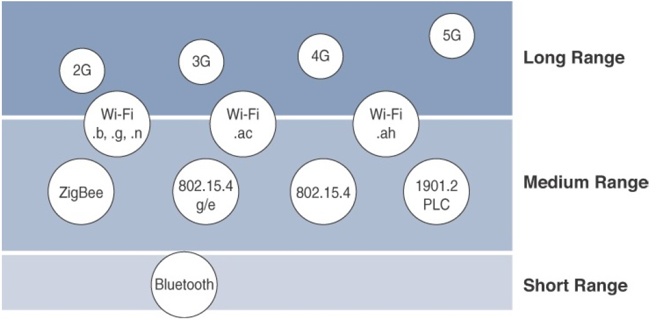
Communication Technologies Criteria: 1- Range
How far does the signal need to be propagated?
the area of coverage for a selected wireless technology
* IoT Fundamentals: Networking Technologies, Protocols, and Use Cases for the Internet of Thing, Cisco press, 2017

Slide 17
Communication Technologies Criteria: 2-Frequency Bands
Licensed:
Generally applicable to IoT long-range access technologies and allocated to communications infrastructures deployed by services providers, public services (for example, first responders, military), broadcasters, and utilities.
Examples: cellular, WiMAX, and Narrowband IoT (NB-IoT) technologies.
Unlicensed:
For the industrial, scientific, and medical (ISM) portions of the radio bands, and they are used in many communications technologies for short-range devices (SRDs).
Examples: 2.4 GHz band as used by IEEE 802.11b/g/n Wi-Fi, IEEE 802.15.1 Bluetooth, and IEEE 802.15.4 WPAN.
* IoT Fundamentals: Networking Technologies, Protocols, and Use Cases for the Internet of Thing, Cisco press, 2017
Notes:
Focusing on IoT access technologies, the frequency bands leveraged by wireless communications are split between licensed and unlicensed bands.
Licensed spectrum is generally applicable to IoT long-range access technologies and allocated to communications infrastructures deployed by services providers, public services (for example, first responders, military), broadcasters, and utilities.
An important consideration for IoT access infrastructures that wish to utilize licensed spectrum is that users must subscribe to services when connecting
their IoT devices. This adds more complexity to a deployment involving large numbers of sensors and other IoT devices, but in exchange for the
subscription fee, the network operator can guarantee the exclusivity of the frequency usage over the target area and can therefore sell a better guarantee
of service.
Improvements have been made in handling the complexity that is inherent when deploying large numbers of devices in the licensed spectrum. Thanks to
the development of IoT platforms, such as the Cisco Jasper Control Center, automating the provisioning, deployment, and management of large numbers
of devices has become much easier. Examples of licensed spectrum commonly used for IoT access are cellular, WiMAX, and Narrowband IoT
(NB-IoT) technologies.
The ITU has also defined unlicensed spectrum for the industrial, scientific, and medical (ISM) portions of the radio bands. These frequencies are used in
many communications technologies for short-range devices (SRDs).
Unlicensed means that no guarantees or protections are offered in the ISM bands for device communications. For IoT access, these are the most wellknown
ISM bands:
2.4 GHz band as used by IEEE 802.11b/g/n Wi-Fi
IEEE 802.15.1 Bluetooth
IEEE 802.15.4 WPAN
An unlicensed band, such as those in the ISM range of frequencies, is not unregulated. National and regional regulations exist for each of the allocated
frequency bands (much as with the licensed bands). These regulations mandate device compliance on parameters such as transmit power, duty cycle
and dwell time, channel bandwidth, and channel hopping.
Unlicensed spectrum is usually simpler to deploy than licensed because it does not require a service provider. However, it can suffer from more interference because other devices may be competing for the same frequency in a specific area. This becomes a key element in decisions for IoT deployments. Should an IoT infrastructure utilize unlicensed spectrum available for private networks or licensed frequencies that are dependent on a service provider? Various LPWA technologies are taking on a greater importance when it comes to answering this question. In addition to meeting low power requirements, LPWA communications are able to cover long distances that in the past required the licensed bands offered by service providers for cellular devices.
Some communications within the ISM bands operate in the sub-GHz range.
Sub-GHz bands are used by protocols such as IEEE 802.15.4, 802.15.4g, and 802.11ah, and LPWA technologies such as LoRa and Sigfox.
The frequency of transmission directly impacts how a signal propagates and its practical maximum range. Either for indoor or outdoor deployments, the sub-GHz frequency bands allow greater distances between devices. These bands have a better ability than the 2.4 GHz ISM band to penetrate building infrastructures or go around obstacles, while keeping the transmit power within regulation.
The disadvantage of sub-GHz frequency bands is their lower rate of data delivery compared to higher frequencies. However, most IoT sensors do not need to send data at high rates. Therefore, the lower transmission speeds of sub-GHz technologies are usually not a concern for IoT sensor deployments.
For example, in most European countries, the 169 MHz band is often considered best suited for wireless water and gas metering applications. This is due to its good deep building basement signal penetration. In addition, the low data rate of this frequency matches the low volume of data that needs to be transmitted.
Several sub-GHz ranges have been defined in the ISM band. The most wellknown ranges are centered on 169 MHz, 433 MHz, 868 MHz, and 915 MHz.
However, most IoT access technologies tend to focus on the two sub-GHz frequency regions around 868 MHz and 915 MHz. These main bands are commonly found throughout the world and are applicable to nearly all countries.

Slide 18
Communication Technologies Criteria: 3- Power Consumption
Powered nodes
have a direct connection to a power source
Battery-powered nodes:
are often classified by the required lifetimes of their batteries.
For devices under regular maintenance, a battery life of 2 to 3 years is an option.
Evolution of a new wireless environment known as Low-Power Wide-Area (LPWA) for battery-powered nodes
* IoT Fundamentals: Networking Technologies, Protocols, and Use Cases for the Internet of Thing, Cisco press, 2017
Notes:
While the definition of IoT device is very broad, there is a clear delineation between powered nodes and battery-powered nodes.
A powered node has a direct connection to a power source, and communications are usually not limited by power consumption criteria. However, ease of deployment of
powered nodes is limited by the availability of a power source, which makes mobility more complex.
Battery-powered nodes bring much more flexibility to IoT devices. These nodes are often classified by the required lifetimes of their batteries. Does a
node need 10 to 15 years of battery life, such as on water or gas meters? Or is a 5- to 7-year battery life sufficient for devices such as smart parking sensors? Their batteries can be changed or the devices replaced when a street gets resurfaced. For devices under regular maintenance, a battery life of 2 to 3 years is an option.
IoT wireless access technologies must address the needs of low power consumption and connectivity for battery-powered nodes. This has led to the evolution of a new wireless environment known as Low-Power Wide-Area (LPWA). Obviously, it is possible to run just about any wireless technology on batteries. However, in reality, no operational deployment will be acceptable if hundreds of batteries must be changed every month.
Wired IoT access technologies consisting of powered nodes are not exempt from power optimization. In the case of deployment of smart meters over PLC, the radio interface on meters can’t consume 5 to 10 watts of power, or this will add up to a 20-million-meter deployment consuming 100 to 200 megawatts of energy for communications.

Slide 19
Communication Technologies Criteria: 4- Topology
Topology (star, mesh, and peer-to-peer)
For long range and short-range technologies, a star topology is prevalent, as seen with cellular, LPWA, and Bluetooth networks.
Star topologies utilize a single central base station or controller to allow communications with endpoints.
For medium-range technologies, a star, peer-to-peer, or mesh topology is common, as shown in Figure 4-2. Peer-to-peer topologies allow any device to communicate with any other device as long as they are in range of each other.
* IoT Fundamentals: Networking Technologies, Protocols, and Use Cases for the Internet of Thing, Cisco press, 2017
Notes:
Topology
Among the access technologies available for connecting IoT devices, three main topology schemes are dominant: star, mesh, and peer-to-peer.
For long range and short-range technologies, a star topology is prevalent, as seen with cellular, LPWA, and Bluetooth networks. Star topologies utilize a single central base station or controller to allow communications with endpoints.
For medium-range technologies, a star, peer-to-peer, or mesh topology is common, as shown in Figure 4-2. Peer-to-peer topologies allow any device to communicate with any other device as long as they are in range of each other. Obviously, peer-to-peer topologies rely on multiple full-function devices.
Peer-to-peer topologies enable more complex formations, such as a mesh networking topology.
For example, indoor Wi-Fi deployments are mostly a set of nodes forming a star topology around their access points (APs). Meanwhile, outdoor Wi-Fi may consist of a mesh topology for the backbone of APs, with nodes connecting to the APs in a star topology. Similarly, IEEE 802.15.4 and 802.15.4g and even wired IEEE 1901.2a PLC are generally deployed as a mesh topology. A mesh topology helps cope with low transmit power, searching to reach a greater overall distance, and coverage by having intermediate nodes relaying traffic for other nodes.
Mesh topology requires the implementation of a Layer 2 forwarding protocol known as mesh-under or a Layer 3 forwarding protocol referred to as mesh over on each intermediate node. (See Chapter 5, “IP as the IoT Network Layer,” for more information.) As discussed previously in Chapter 2, “IoT Network Architecture and Design,” an intermediate node or full-function device (FFD) is simply a node that interconnects other nodes. A node that doesn’t interconnect or relay the traffic of other nodes is known as a leaf node, or reduced-function device (RFD).
While well adapted to powered nodes, mesh topology requires a properly optimized implementation for battery-powered nodes. Battery-powered nodes are often placed in a “sleep mode” to preserve battery life when not transmitting. In the case of mesh topology, either the battery-powered nodes act as leaf nodes or as a “last resource path” to relay traffic when used as intermediate nodes. Otherwise, battery lifetime is greatly shortened.
For battery-powered nodes, the topology type and the role of the node in the topology (for example, being an intermediate or leaf node) are significant factors for a successful implementation.

Slide 20
Communication Technologies Criteria: 5- Constrained Devices
Classes of Constrained Nodes, as Defined by RFC 7228
Constrained nodes have limited resources that impact their networking feature set and capabilities.
Classes of Constrained Nodes, as Defined by RFC 7228:
Class 0: are typically battery-powered nodes such as push button nodes that sends 1 byte of information when changing its status
Memory << 10 KB
Processing capability and storage << 100 KB
Class 1: are capable enough to use a protocol stack specifically designed for constrained nodes
Memory ~ 10 KB
Processing capability and storage ~ 100 KB
Class 2:
Memory > 50 KB
Processing capability and storage > 250 KB
Notes:
Class 0 devices are very constrained sensor-like motes. They are so severely constrained in memory and processing capabilities that most likely they will not have the resources required to communicate directly with the Internet in a secure manner (rare heroic, narrowly targeted implementation efforts notwithstanding). Class 0 devices will participate in Internet communications with the help of larger devices acting as proxies, gateways, or servers. Class 0 devices generally cannot be secured or managed comprehensively in the traditional sense. They will most likely be preconfigured (and will be reconfigured rarely, if at all) with a very small data set. For management purposes, they could answer keep alive signals and send on/ off or basic health indications.
Class 1 devices are quite constrained in code space and processing capabilities, such that they cannot easily talk to other Internet nodes employing a full protocol stack such as using HTTP, Transport Layer Security (TLS), and related security protocols and XML-based data representations. However, they are capable enough to use a protocol stack specifically designed for constrained nodes (such as the Constrained Application Protocol (CoAP) over UDP [COAP]) and participate in meaningful conversations without the help of a gateway node. In particular, they can provide support for the security functions required on a large network. Therefore, they can be integrated as fully developed peers into an IP network, but they need to be parsimonious with state memory, code space, and often power expenditure for protocol and application usage.
Class 2 devices are less constrained and fundamentally capable of supporting most of the same protocol stacks as used on notebooks or servers. However, even these devices can benefit from lightweight and energy-efficient protocols and from consuming less bandwidth. Furthermore, using fewer resources for networking leaves more resources available to applications. Thus, using the protocol stacks defined for more constrained devices on Class 2 devices might reduce development costs and increase the interoperability.

Slide 21
Communication Technologies Criteria: 6- Constrained-Node Networks
Several of the IoT access technologies, such as Wi-Fi and cellular, are applicable to laptops, smart phones, and some IoT devices,
Some IoT access technologies are more suited to specifically connect constrained nodes.
Typical examples are IEEE 802.15.4 and 802.15.4g RF, IEEE 1901.2a PLC,
LPWA, and IEEE 802.11ah access technologies.
These technologies are discussed in more detail later in this chapter.

Slide 22
Communication Technologies Criteria: 6- Constrained-Node Networks
Constrained-Node Networks are often referred to as low-power and lossy networks (LLNs).
Low-power refers to the fact that nodes must cope with the requirements from powered and battery-powered constrained nodes.
Lossy networks indicates that network performance may suffer from interference and variability due to harsh radio environments.
* IoT Fundamentals: Networking Technologies, Protocols, and Use Cases for the Internet of Thing, Cisco press, 2017

Slide 23
Communication Technologies Criteria: 6- Constrained-Node Networks
Layer 1 and Layer 2protocols that can be used for constrained-node networks must be evaluated in the context of the following characteristics for use-case applicability:
Data rate and throughput → Low data rate needed
Latency → Quality of service is not as important as regular internet applications though it depends on the application
Overhead and payload → IoT systems messages are small packets, consequently they must have small headers to decrease overhead
* IoT Fundamentals: Networking Technologies, Protocols, and Use Cases for the Internet of Thing, Cisco press, 2017
Notes:
In context of real time systems by deterministic we mean a guaranteed upper limit on latency under all system conditions.

Slide 24
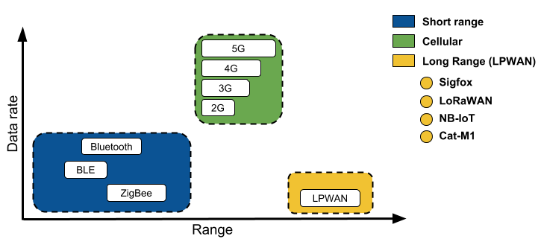
IoT Protocol Stack- Physical and Link Layers Protocols

Slide 25
Low Power Wide Area Network (LPWAN)
Long-Range
Long Range Communications (WAN)
Low Number of Required BSs
Low data rate
Less than 10 Kb/s
Low-Power
Batteries last up to 10 years
Low-Subscription Cost

Slide 26
LPWAN- Design Goals
The success of LPWA technologies lies in their ability to offer low-power connectivity to massive number of devices distributed over large geographical areas at an unprecedented low-cost
The key objective of LPWA technologies to achieve
a long range
with low power consumption and
low cost
Scalability (massive number of devices )
Low-rate
This is unlike that of the other technologies for which achieving higher data rate, lower latency and higher reliability may be more important.

Slide 27
Techniques for Achieving Design Goals in LPWAN
Techniques for achieving Long-ranges
Use of Sub-1GHz band
Firstly, compared to the 2.4 GHz band, the lower frequency signals experience less attenuation and multipath fading caused by obstacles and dense surfaces like concrete walls.
Secondly, sub-GHz is less congested than 2.4 GHz, a band used by mostpopular wireless technologies e.g., Wi-Fi, cordless phones, Bluetooth, ZigBee
Modulation Techniques:
Narrowband
Spread Spectrum

Slide 28
Techniques for Achieving Design Goals in LPWAN
Low Power
Topology → Scalable
Duty Cycling
Lightweight Medium Access Control
Offloading complexity from end devices

Slide 29
Techniques for Achieving Design Goals in LPWAN
Low Cost
The commercial success of LPWA networks is tied to connecting a large number of end devices, while keeping the cost of hardware below $5 and the connectivity subscription per unit as low as $1.
LPWA technologies adopt several ways to reduce the capital expenses (CAPEX) and operating expenses (OPEX) for both the end-users and network operators.
Use of star-type (instead of mesh) connectivity,
Simple MAC protocols,
Techniques to offload complexity from end devices enables manufacturers to design simple and therefore low-cost end devices.
Reduction in hardware complexity
Minimum infrastructure
Using license-free or owned licensed bands

Slide 30
LPWANs
SigFox:
Developed in 2010 by the startup Sigfox (in France)
Operates and commercializes its own IoT solution in 31 countries
LoRaWAN
First developed by the start-up Cycleo in 2009 (in France) and was purchased three years later by Semtech (USA)
In 2015, LoRa was standardized by LoRa-Alliance and is deployed in 42 countries
Investment of various mobile operators (e.g., Bouygues and Orange in France, KPN in Netherlands, and Fastnet in South Africa)
NB-IoT
Based on narrow band radio technology and is standardized by the 3GPP (Release 13 on June 2016)
In December 2016, Vodafone and Huawei integrated NB-IoT into the Spanish Vodafone network.

Slide 31
SigFox
SigFox
The Sigfox technology was developed in 2010 by the startup Sigfox (in Toulouse, France),
Sigfox operates and commercializes its own IoT solution in 31 countries and is still under rollout worldwide owing to the partnership with various network operators

Slide 32
SigFox: Technical Specification
Binary phase-shift keying (BPSK) modulation in an ultra-narrow band (100 Hz) sub- GHZ ISM band carrier
It causes SigFox experiences
very low noise levels,
leading to very low power consumption,
high receiver sensitivity,
and low-cost antenna design
all, at the expense of maximum throughput of only 100 bps.

Slide 33
SigFox: Technical Specification
The downlink communication can only occur following an uplink communication.
The number of messages over the uplink is limited to 140 messages per day.
The maximum payload length for each uplink message is 12 bytes.
However, the number of messages over the downlink is limited to 4 messages per day, which means that the acknowledgment of every uplink message is not supported.

Slide 34
NB-IoT and Other LTE Variations
Existing cellular technologies,
2G (GPRS, Edge), 3G, and 4G/LTE,
are not particularly well adapted to battery-powered devices and small objects specifically developed for the Internet of Things.
While industry players have been developing unlicensed-band LPWA technologies, 3GPP and associated vendors have been working on evolving cellular technologies to better address IoT requirements.
low throughput and low power consumption, and decrease the complexity and cost of the LTE devices.
This resulted in the definition of the LTE-M work item.
* IoT Fundamentals: Networking Technologies, Protocols, and Use Cases for the Internet of Thing, Cisco press, 2017

Slide 35
NB-IoT and Other LTE Variations
Because the new LTE-M device category was not sufficiently close to LPWA capabilities, in 2015 3GPP approved a proposal to standardize a new narrowband radio access technology called Narrowband IoT (NB-IoT).
NB-IoT specifically addresses
the requirements of a massive number of low throughput devices,
low device power consumption,
improved indoor coverage,
and optimized network architecture.
* IoT Fundamentals: Networking Technologies, Protocols, and Use Cases for the Internet of Thing, Cisco press, 2017

Slide 36
NB-IoT and Other LTE Variations
Mobile vendors and service providers are not willing to lose leadership in this market of connecting IoT devices
Licensed LPWAN:
LTE Cat 0
LTE-M
NB-IoT
* IoT Fundamentals: Networking Technologies, Protocols, and Use Cases for the Internet of Thing, Cisco press, 2017

Slide 37
LTE Cat 0
The first enhancements to better support IoT devices in 3GPP occurred in LTE Release 12.
A new user equipment (UE) category, Category 0, was added, with devices running at a maximum data rate of 1 Mbps.
Category 0 includes important characteristics to be supported by both the network and end devices.
Meanwhile, the UE still can operate in existing LTE systems with bandwidths up to 20 MHz.
* IoT Fundamentals: Networking Technologies, Protocols, and Use Cases for the Internet of Thing, Cisco press, 2017

Slide 38
LTE-M
Following LTE Cat 0, the next step in making the licensed spectrum more supportive of IoT devices was the introduction of the LTE-M category for 3GPP LTE Release 13.
LTE-M requires new chipsets and additional software development.
Commercial deployment is expected in 2017.
Mobile carriers expect that only new LTE-M software will be required on the base stations, which will prevent re-investment in hardware.
* IoT Fundamentals: Networking Technologies, Protocols, and Use Cases for the Internet of Thing, Cisco press, 2017

Slide 39
NB-IoT
Recognizing that the definition of new LTE device categories was not sufficient to support LPWA IoT requirement, 3GPP specified Narrowband IoT (NB-IoT).
Three modes of operation are applicable to NB-IoT:
Standalone
A GSM carrier is used as an NB-IoT carrier, enabling reuse of 900 MHz or 1800 MHz.
In-band
Part of an LTE carrier frequency band is allocated for use as an NB-IoT frequency.
Guard band
An NB-IoT carrier is between the LTE or WCDMA bands.
This requires coexistence between LTE and NB-IoT bands.
* IoT Fundamentals: Networking Technologies, Protocols, and Use Cases for the Internet of Thing, Cisco press, 2017

Slide 40
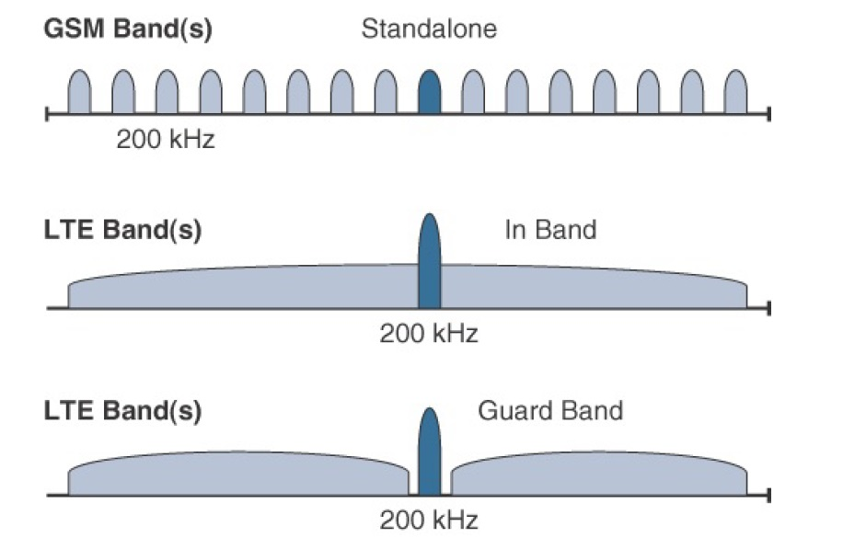
Physical and Link Layers Protocols- NB-IoT
NB-IoT
Notes:
Three modes of operation are applicable to NB-IoT:
Standalone: A GSM carrier is used as an NB-IoT carrier, enabling reuse of 900 MHz or 1800 MHz.
In-band: Part of an LTE carrier frequency band is allocated for use as an NB-IoT frequency. The service provider typically makes this allocation, and IoT devices are configured accordingly. You should be aware that if these devices must be deployed across different countries or regions using a different service provider, problems may occur unless there is some coordination between the service providers, and the NB-IoT frequency band allocations are the same.
Guard band: An NB-IoT carrier is between the LTE or WCDMA bands. This requires coexistence between LTE and NB-IoT bands.
Mobile service providers consider NB-IoT the target technology as it allows them to leverage their licensed spectrum to support LPWA use cases. For instance, NB-IoT is defined for a 200-kHz-wide channel in both uplink and downlink, allowing mobile service providers to optimize their spectrum, with a number of deployment options for GSM, WCDMA, and LTE spectrum.
In an LTE network, resource blocks are defined with an effective bandwidth of 180 kHz, while on NB-IoT, tone or subcarriers replace the LTE resource blocks. The uplink channel can be 15 kHz or 3.75 kHz or multi-tone (n*15 kHz, n up to 12). At Layer 1, the maximum transport block size (TBS) for downlink is 680 bits, while uplink is 1000 bits. At Layer 2, the maximum acket Data Convergence Protocol (PDCP) service data unit (SDU) size is 1600 bytes.
NB-IoT operates in half-duplex frequency-division duplexing (FDD) mode with a maximum data rate uplink of 60 kbps and downlink of 30 kbps.

Slide 41
Physical and Link Layers Protocols- LoRaWAN
LoRaWAN
LoRaWAN is an example of an unlicensed-band Low-Power Wide-Area (LPWA) technology.
LPWA particularly well adapted for long-range and battery-powered endpoints.
* IoT Fundamentals: Networking Technologies, Protocols, and Use Cases for the Internet of Thing, Cisco press, 2017

Slide 42
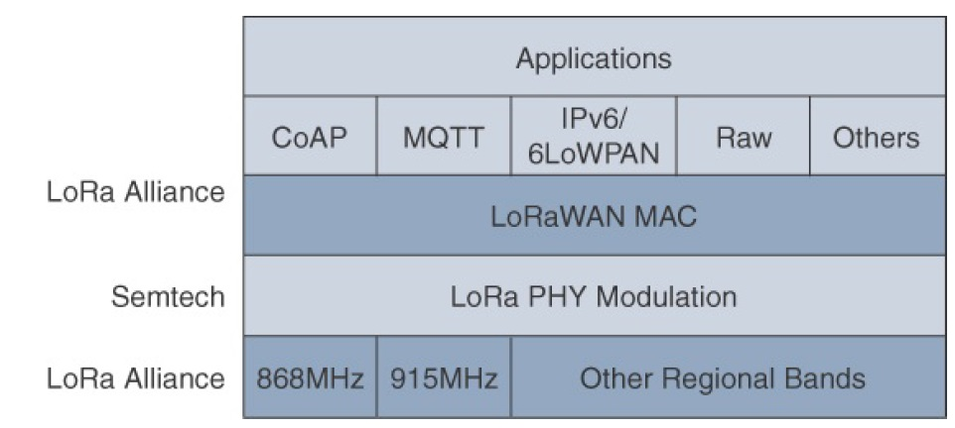
Physical and Link Layers Protocols- LoRaWAN
LoRaWAN Layers
Semtech is responsible for the PHY layer, while the LoRa Alliance handles the MAC layer and regional frequency bands
Notes:
Initially, LoRa was a physical layer, or Layer 1, modulation that was developed by a French company named Cycleo. Later, Cycleo was acquired by Semtech.
Optimized for long-range, two-way communications and low power consumption, the technology evolved from Layer 1 to a broader scope through the creation of the LoRa Alliance.
Semtech LoRa as a Layer 1 PHY modulation technology is available through multiple chipset vendors. To differentiate from the physical layer modulation known as LoRa, the LoRa Alliance uses the term LoRaWAN to refer to its architecture and its specifications that describe end-to-end LoRaWAN communications and protocols.
In this figure, notice that Semtech is responsible for the PHY layer, while the LoRa Alliance handles the MAC layer and regional frequency bands.
Overall, the LoRa Alliance owns and manages the roadmap and technical development of the LoRaWAN architecture and protocol. This alliance also handles the LoRaWAN endpoint certification program and technology promotion through its certification and marketing committees.

Slide 43
LoRa Specification
The range between LoRa sender and receiver depends on the environment the equipment operates in. Indoor coverage largely depends on the type of building material used.
Environment | Range (km)
Urban areas (towns & cities) | 2-5
Rural areas (country sides) | 5-15
Direct Line of Sight | >15
Some notable records: Andreas Spiess, ground to ground connection: 212 km (= 131.73 miles) Weather balloon to ground connection: 702.67 km (= 436.61 miles)

Slide 44
LoRaWAN- Topology
LoRaWAN
Topology
Star of stars
* IoT Fundamentals: Networking Technologies, Protocols, and Use Cases for the Internet of Thing, Cisco press, 2017
Notes:
LoRaWAN topology is often described as a “star of stars” topology. As shown in this figure, the infrastructure consists of endpoints exchanging packets through gateways acting as bridges, with a central LoRaWAN network server. Gateways connect to the backend network using standard IP connections, and endpoints communicate directly with one or more gateways.
LoRaWAN endpoints transport their selected application data over the LoRaWAN MAC layer on top of one of the supported PHY layer frequency bands. The application data is contained in upper protocol layers.
These upper layers are not the responsibility of the LoRa Alliance, but best practices may be developed and recommended. These upper layers could just be raw data on top of the LoRaWAN MAC layer, or the data could be stacked in multiple protocols. For example, you could have upper-layer protocols, such as ZigBee Control Layer (ZCL), Constrained Application Protocol (CoAP), or Message Queuing Telemetry Transport (MQTT), with or without an IPv6/6LoWPAN layer.
LoRaWAN gateways act as bridges that relay between endpoints and the network servers. Multiple gateways can receive and transport the same packets. When duplicate packets are received, deduplication is a function of the network server.

Slide 45
LoRaWAN- Topology
End-devices:
Perform the communication gateways using LoRa and LoRaWAN technologies.
Gateways (i.e., base stations):
Dispatch the LoRaWAN frames from the end devices to a network server using a back-haul interface with higher throughput, usually via Ethernet, 3G/4G, satellite or Wi-Fi.
The Network Server:
Decodes the packets sent by the devices, performing security checks and adaptive data rate, thus generating the control data that should be sent back to the devices.
Each Application:
Receives data from the network server. It should decode the security packets and uses the information to decide the action in the application.
Notes:
LoRaWAN topology is often described as a “star of stars” topology. As shown in this figure, the infrastructure consists of endpoints exchanging packets through gateways acting as bridges, with a central LoRaWAN network server. Gateways connect to the backend network using standard IP connections, and endpoints communicate directly with one or more gateways.
LoRaWAN endpoints transport their selected application data over the LoRaWAN MAC layer on top of one of the supported PHY layer frequency bands. The application data is contained in upper protocol layers.
These upper layers are not the responsibility of the LoRa Alliance, but best practices may be developed and recommended. These upper layers could just be raw data on top of the LoRaWAN MAC layer, or the data could be stacked in multiple protocols. For example, you could have upper-layer protocols, such as ZigBee Control Layer (ZCL), Constrained Application Protocol (CoAP), or Message Queuing Telemetry Transport (MQTT), with or without an IPv6/6LoWPAN layer.
LoRaWAN gateways act as bridges that relay between endpoints and the network servers. Multiple gateways can receive and transport the same packets. When duplicate packets are received, deduplication is a function of the network server.

Slide 46
LoRaWAN- How It Works?
End Node
broadcast its data to every gateway in its vicinity.
Gateways:
Forward this packet to the network server. It is only a protocol convertor.
Network Server:
Collects the messages from all gateways and filters out the duplicate data and determines the gateway that has the best reception.
Forwards the packet to the correct application server where the end user can process the sensor data.
Optionally the application server can send a response back to the end node.
When a response is sent, the network server receives the response and determines which gateway to use to broadcast the response back to the end node.

Slide 47
LoRaWAN- Topology
LoRa is an acronym for Long Range and it is a wireless technology where a low powered sender transmit small data packages (0.3 kbps to 5.5 kbps) to a receiver over a long distance.
A gateway can handle hundreds of devices at the same time.
The Things Gateway
(gateway / concentrator)
The Things Uno (end node)

Slide 48
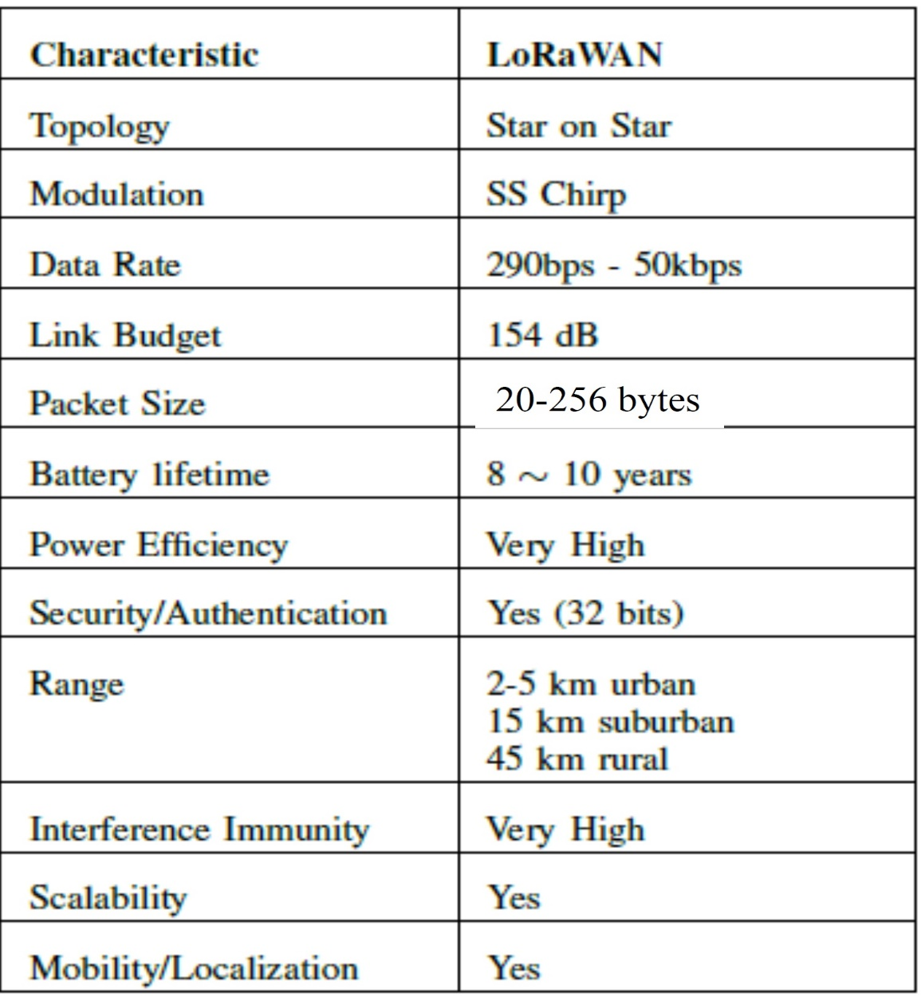
LoRaWAN: Specification
The most critical factors in a LPWAN are:
Network architecture;
Communication range;
Battery lifetime (low power);
Robustness to interference;
Network capacity (maximum number of nodes in a network);
Network security;
One-way vs two-way communication;

Slide 49
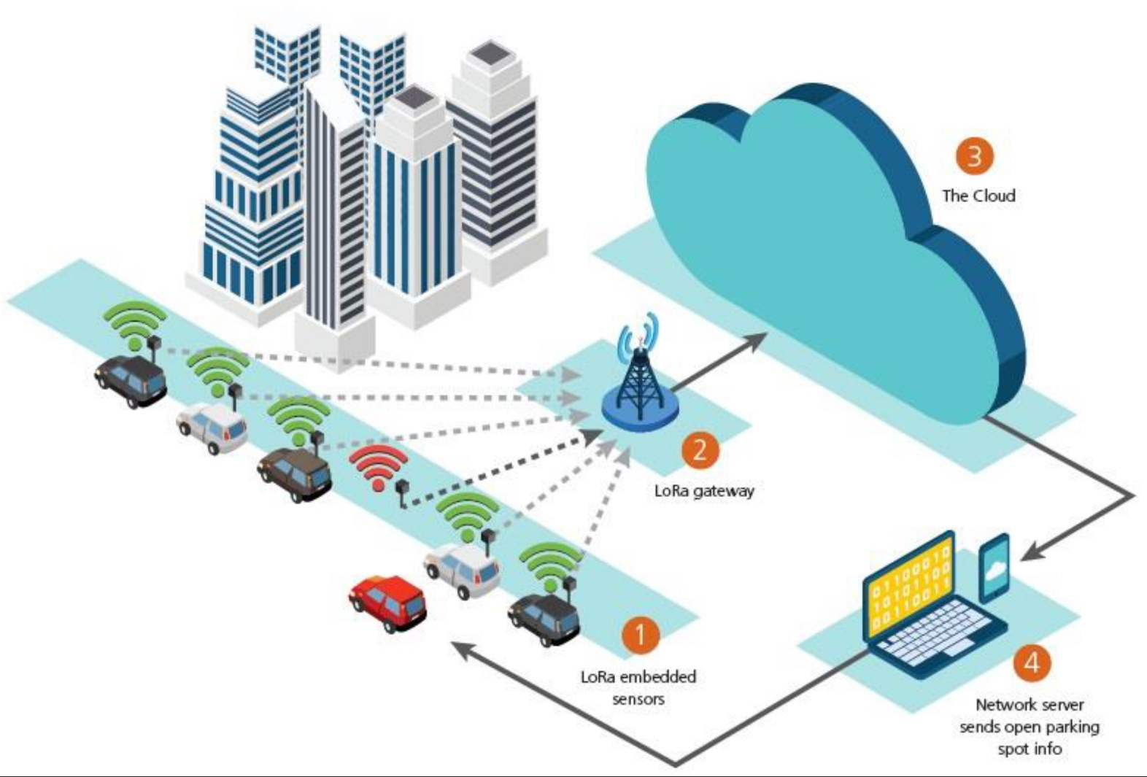
LoRaWAN Use Case- Parking Occupancy
IOT and LORAWAN, Quaenet, 2018

Slide 50
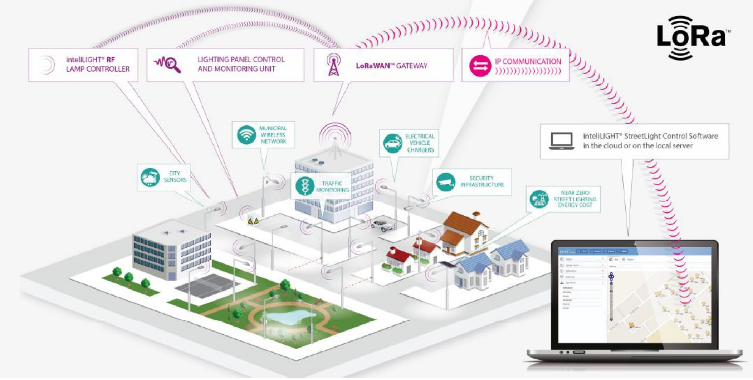
LoRaWAN Use Case- Smart Lighting
IOT and LORAWAN, Quaenet, 2018

Slide 51
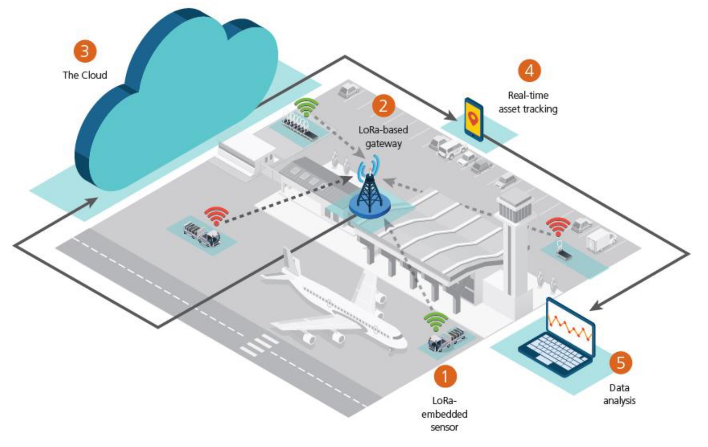
LoRaWAN Use Case- Asset Management
IOT and LORAWAN, Quaenet, 2018

Slide 52
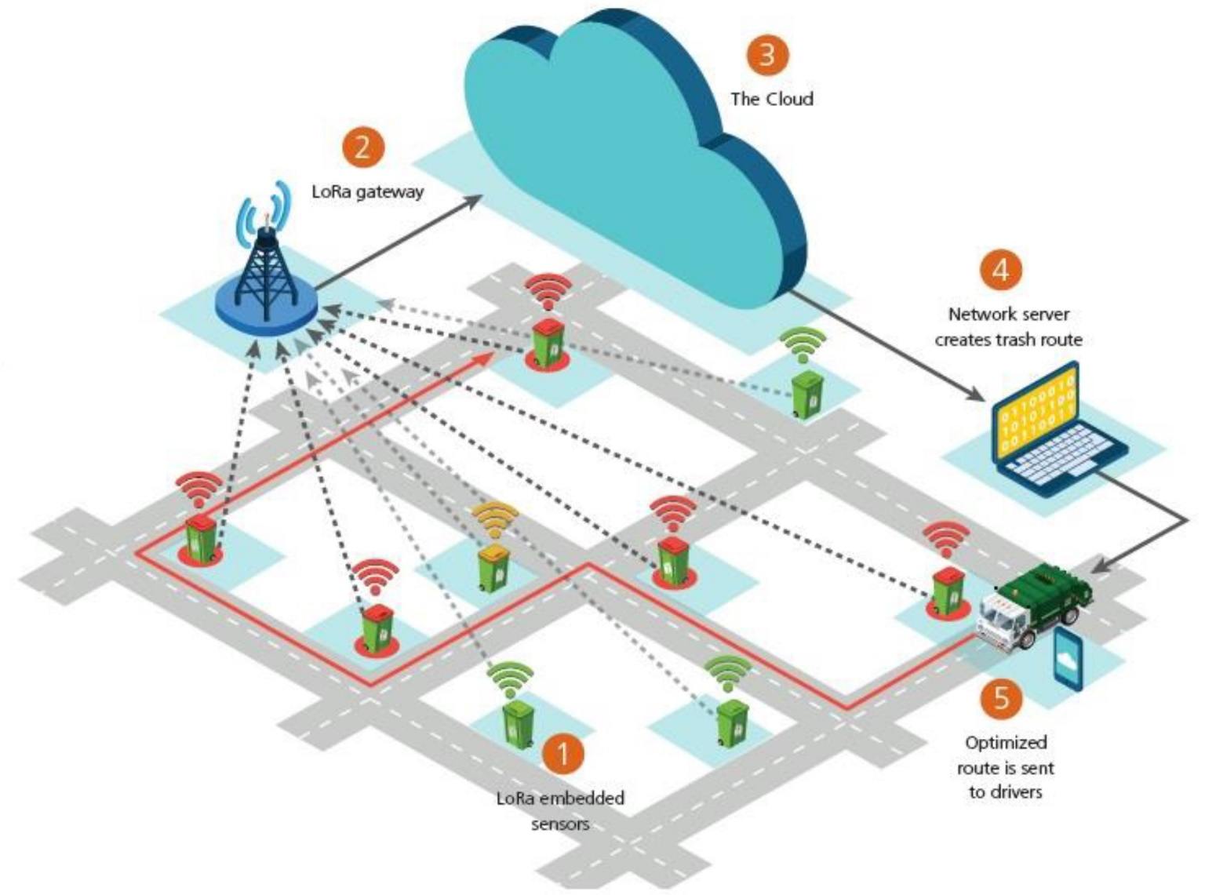
LoRaWAN Use Case- Smart Waste Management
IOT and LORAWAN, Quaenet, 2018

Slide 53
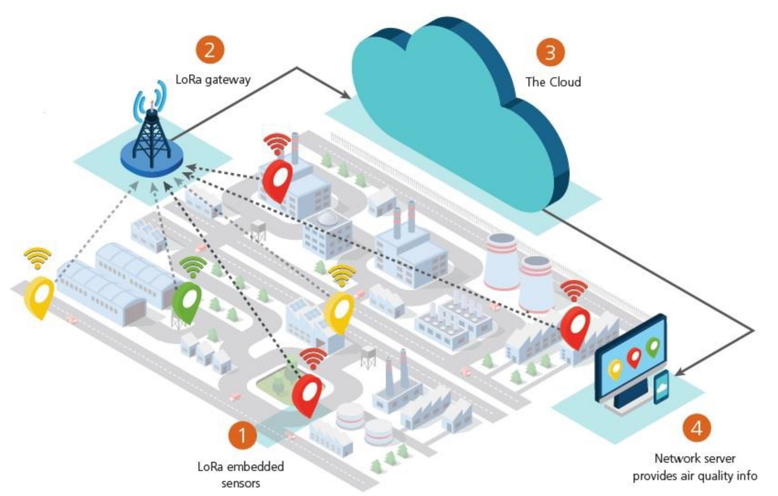
LoRaWAN Use Case- Smart Environment
IOT and LORAWAN, Quaenet, 2018

Slide 54
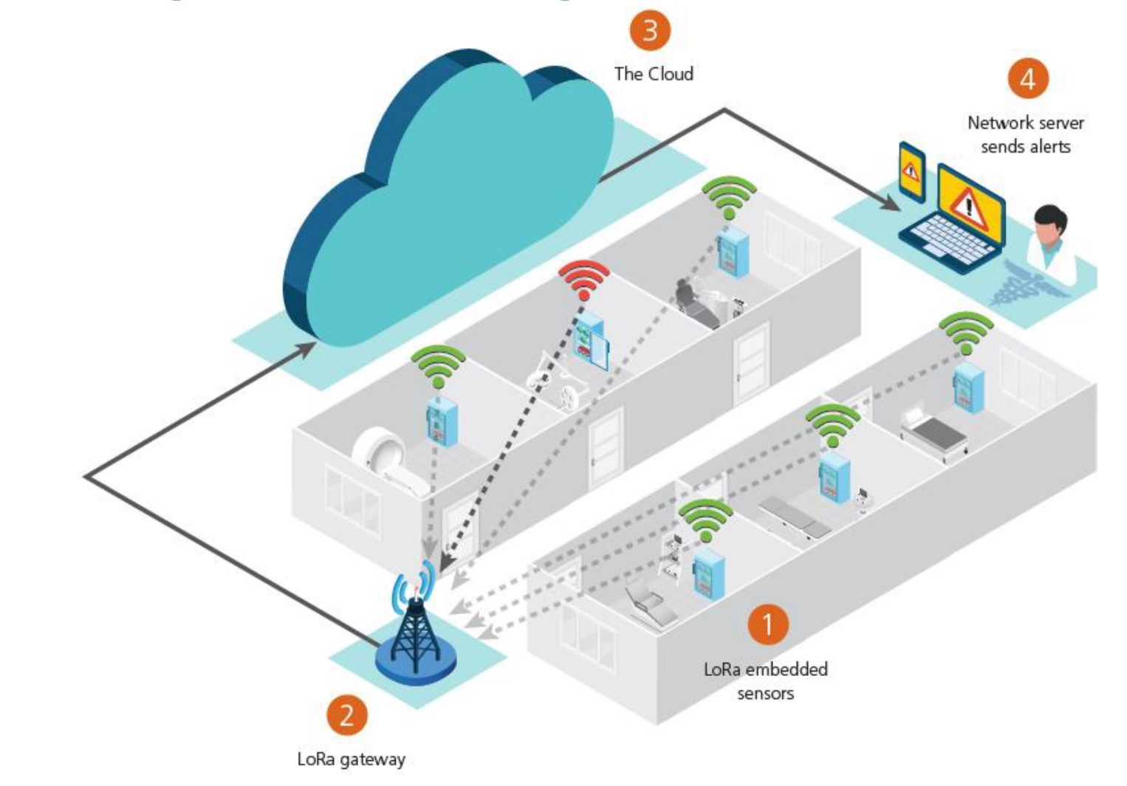
LoRaWAN Use Case- Cold Storage Monitoring
IOT and LORAWAN, Quaenet, 2018

Slide 55
LoRaWAN- Physical Layer
LoRaWAN 1.0.2 regional specifications describe the use of the main unlicensed sub-GHz frequency bands of
433 MHz,
779–787 MHz,
863–870 MHz,
and 902–928 MHz,
as well as regional profiles for a subset of the 902–928 MHz bandwidth
For example, Australia utilizes 915–928 MHz frequency bands, while South Korea uses 920–923 MHz and Japan uses 920–928 MHz.
* IoT Fundamentals: Networking Technologies, Protocols, and Use Cases for the Internet of Thing, Cisco press, 2017
Notes:
Physical Layer
Semtech LoRa modulation is based on chirp spread spectrum modulation, which trades a lower data rate for receiver sensitivity to significantly increase the communication distance. In addition, it allows demodulation below the noise floor, offers robustness to noise and interference, and manages a single channel occupation by different spreading factors. This enables LoRa devices to receive on multiple channels in parallel.
The data rate in LoRaWAN varies depending on the frequency bands and adaptive data rate (ADR). ADR is an algorithm that manages the data rate and radio signal for each endpoint. The ADR algorithm ensures that packets are delivered at the best data rate possible and that network performance is both optimal and scalable. Endpoints close to the gateways with good signal values transmit with the highest data rate, which enables a shorter transmission time over the wireless network, and the lowest transmit power. Meanwhile, endpoints at the edge of the link budget communicate at the lowest data rate and highest transmit power.
An important feature of LoRa is its ability to handle various data rates via the spreading factor. Devices with a low spreading factor (SF) achieve less distance in their communications but transmit at faster speeds, resulting in less airtime. A higher SF provides slower transmission rates but achieves a higher reliability at longer distances.

Slide 56
ISM Band and Duty Cycle
In Europe when using the ISM band frequencies (863 MHz - 870 MHz) users must comply to the following rules:
For uplink, the maximum transmission power is limited to 25mW (14 dBm).
For downlink (for 869.525MHz), the maximum transmission power is limited to 0.5W (27 dBm)
There is an 0.1% and 1.0% duty cycle per day depending on the channel.
Besides these ISM band rules, the network service provider (for example The Things Network) can also add additional restrictions.

Slide 57
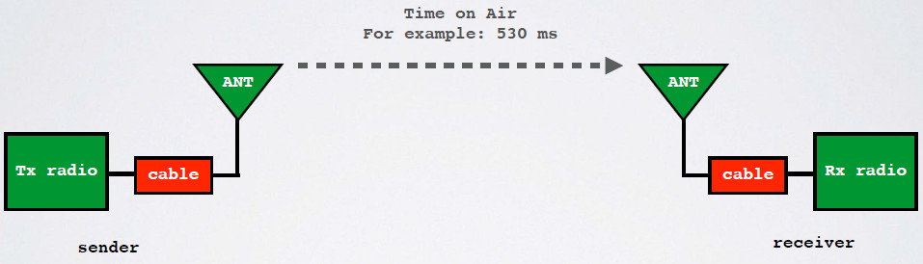
Time on Air (ToA)
Duty cycle is the proportion of time during which a component, device, or system is operated. The duty cycle can be expressed as a ratio or as a percentage.
As mentioned previously in Europe there is a 0.1% and 1.0% duty cycle per day depending on the channel.

Slide 58
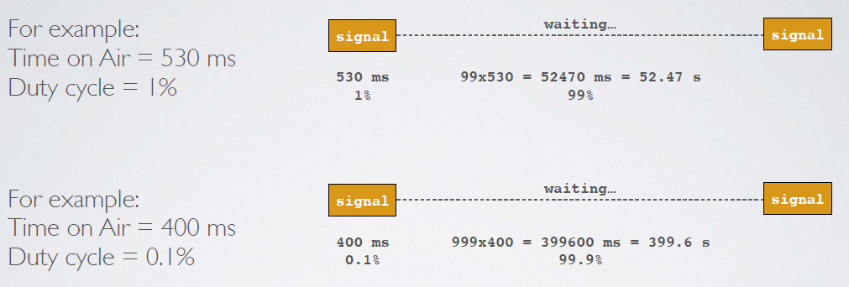
Duty Cycle

Slide 59
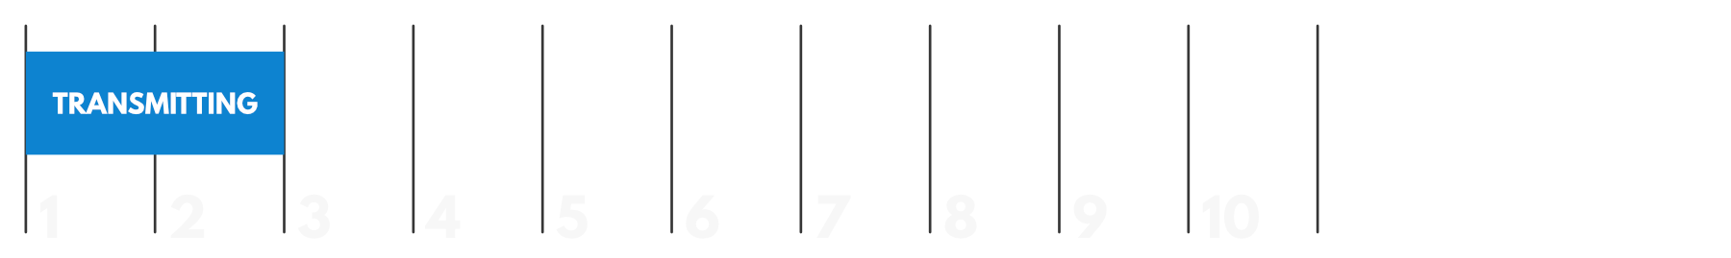
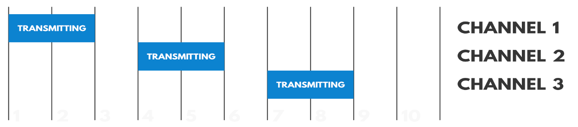
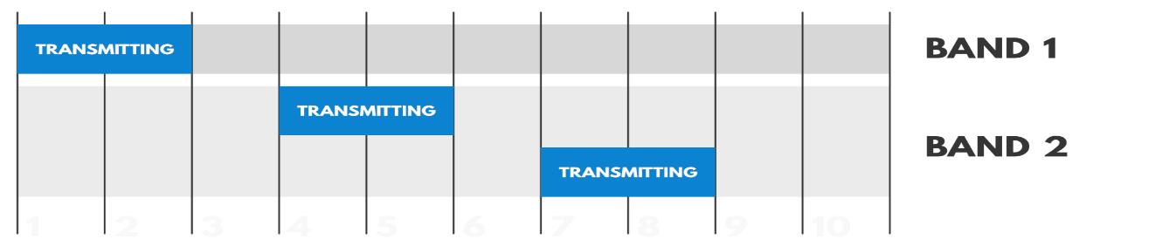
Duty Cycle
Duty-cycle regulations in the ISM bands: The maximum time each device may occupy the channel
duty cycle = 20%
duty cycle = 60%
duty cycle = 20%
duty cycle = 40%
” Duty Cycle for LoRaWAN Devices”, https://www.thethingsnetwork.org/docs/lorawan/duty-cycle.html

Slide 60
LoRaWAN- Physical Layer
Semtech LoRa modulation is based on chirp spread spectrum modulation, which trades a lower data rate for receiver sensitivity to significantly increase the communication distance.
It allows demodulation below the noise floor, offers robustness to noise and interference, and manages a single channel occupation by different spreading factors.
An important feature of LoRa is its ability to handle various data rates via the spreading factor.
* IoT Fundamentals: Networking Technologies, Protocols, and Use Cases for the Internet of Thing, Cisco press, 2017
Notes:
Physical Layer
Semtech LoRa modulation is based on chirp spread spectrum modulation, which trades a lower data rate for receiver sensitivity to significantly increase the communication distance. In addition, it allows demodulation below the noise floor, offers robustness to noise and interference, and manages a single channel occupation by different spreading factors. This enables LoRa devices to receive on multiple channels in parallel.
The data rate in LoRaWAN varies depending on the frequency bands and adaptive data rate (ADR). ADR is an algorithm that manages the data rate and radio signal for each endpoint. The ADR algorithm ensures that packets are delivered at the best data rate possible and that network performance is both optimal and scalable. Endpoints close to the gateways with good signal values transmit with the highest data rate, which enables a shorter transmission time over the wireless network, and the lowest transmit power. Meanwhile, endpoints at the edge of the link budget communicate at the lowest data rate and highest transmit power.
An important feature of LoRa is its ability to handle various data rates via the spreading factor. Devices with a low spreading factor (SF) achieve less distance in their communications but transmit at faster speeds, resulting in less airtime. A higher SF provides slower transmission rates but achieves a higher reliability at longer distances.

Slide 61
LoRaWAN- Physical Layer
The Data Rate Story: There are three physical factors:
transmission power,
bandwidth
spreading factor
If you lower the tx power, you’ll save battery, but the range of the signal will obviously be shorter.
The other two factors (spreading factor and bandwidth) combined form the data rate. This determines how fast bytes are transmitted.

Slide 62
LoRaWAN- Physical Layer
http://www.linuxembedded.fr/2017/12/introduction-a-lora/

Slide 63
LoRaWAN- Adaptive Data Rate
Adaptive Data Rate (ADR) is a mechanism for optimizing data rates, airtime and energy consumption in the network.
End devices decide if ADR should be used or not, not the application or the network.

Slide 64
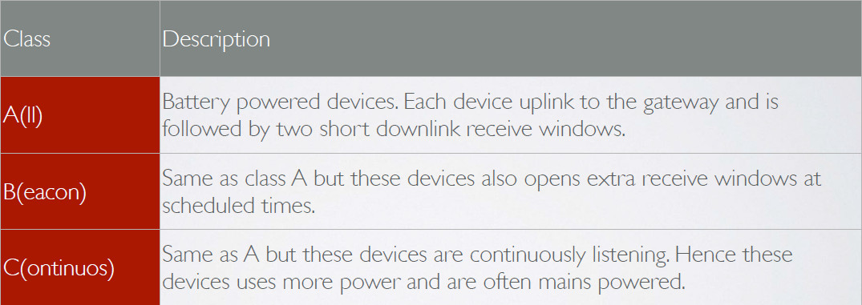
LoRaWAN Device Clases
The LoRaWAN specification defines three device classes:

Slide 65
LoRaWAN- Security
LoRaWAN considers two layers of security, one for the network and another for the applications.
Each end-device has key assignments done by device manufacturers or the application owners.
Other systems use a single key for encryption and authentication, compared to LoRaWAN.
Authentication and encryption are separate, so it is possible to authenticate packets and provide integrity protection.
J. Silva, etl, LoRaWAN - A Low Power WAN Protocol for Internet of Things: a Review and Opportunities, 2th Int. Multidisciplinary Conf. on Computer and Energy Science, 2017
Notes:
MAC layer
LoRaWAN messages, either uplink or downlink, have a PHY payload composed of a 1-byte MAC header, a variable-byte MAC payload, and a MIC that is 4 bytes in length. The MAC payload size depends on the frequency band and the data rate, ranging from 59 to 230 bytes for the 863–870 MHz band and 19 to 250 bytes for the 902–928 MHz band.
LoRaWAN endpoints are uniquely addressable through a variety of methods, including the following:
An endpoint can have a global end device ID or DevEUI represented as an IEEE EUI-64 address.
An endpoint can have a global application ID or AppEUI represented as an IEEE EUI-64 address that uniquely identifies the application provider, such as the owner, of the end device.
In a LoRaWAN network, endpoints are also known by their end device address, known as a DevAddr, a 32-bit address. The 7 most significant bits are the network identifier (NwkID), which identifies the LoRaWAN network. The 25 least significant bits are used as the network address (NwkAddr) to identify the endpoint in the network.

Slide 66
LoRaWAN- Security
LoRaWAN endpoints attached to a LoRaWAN network must get registered and authenticated. This can be achieved through one of the two join mechanisms:
Activation by personalization (ABP):
Endpoints don’t need to run a join procedure as their individual details, including DevAddr and the NwkSKey and AppSKey session keys, are preconfigured and stored in the end device. This same information is registered in the LoRaWAN network server.
Over-the-air activation (OTAA):
Endpoints are allowed to dynamically join a particular LoRaWAN network after successfully going through a join procedure. The join procedure must be done every time a session context is renewed.
During the join process, which involves the sending and receiving of MAC layer join request and join accept messages, the node establishes its credentials with a LoRaWAN network server, exchanging its globally unique DevEUI, AppEUI, and AppKey. The AppKey is then used to derive the session NwkSKey and AppSKey keys.
Notes:
MAC layer
LoRaWAN messages, either uplink or downlink, have a PHY payload composed of a 1-byte MAC header, a variable-byte MAC payload, and a MIC that is 4 bytes in length. The MAC payload size depends on the frequency band and the data rate, ranging from 59 to 230 bytes for the 863–870 MHz band and 19 to 250 bytes for the 902–928 MHz band.
LoRaWAN endpoints are uniquely addressable through a variety of methods, including the following:
An endpoint can have a global end device ID or DevEUI represented as an IEEE EUI-64 address.
An endpoint can have a global application ID or AppEUI represented as an IEEE EUI-64 address that uniquely identifies the application provider, such as the owner, of the end device.
In a LoRaWAN network, endpoints are also known by their end device address, known as a DevAddr, a 32-bit address. The 7 most significant bits are the network identifier (NwkID), which identifies the LoRaWAN network. The 25 least significant bits are used as the network address (NwkAddr) to identify the endpoint in the network.

Slide 67
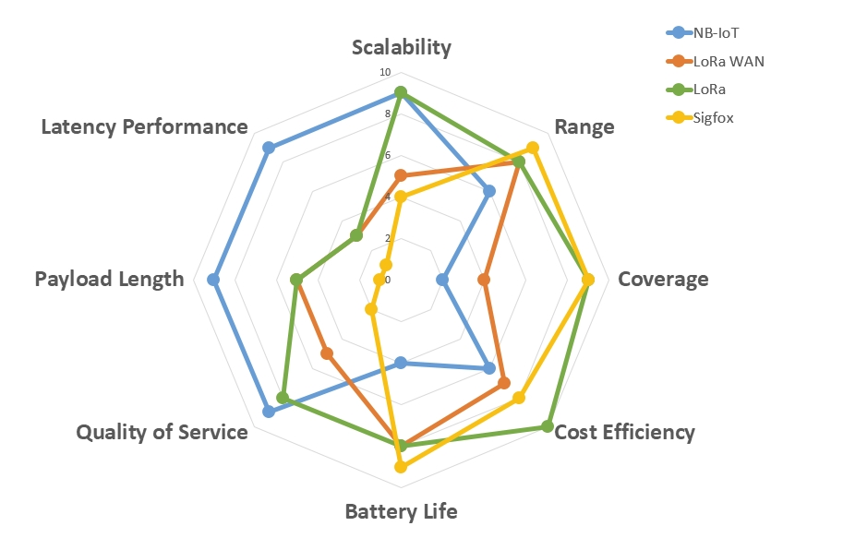
Communication Technologies Comparison
Comparison of SigFox, LoRa, LoRaWAN, and NB-IoT in terms of different criteria
* https://www.betasolutions.co.nz/Blog/25/20-Things-to-Consider-When-Planning-an-IoT-Solution-_-Part-2

Slide 68
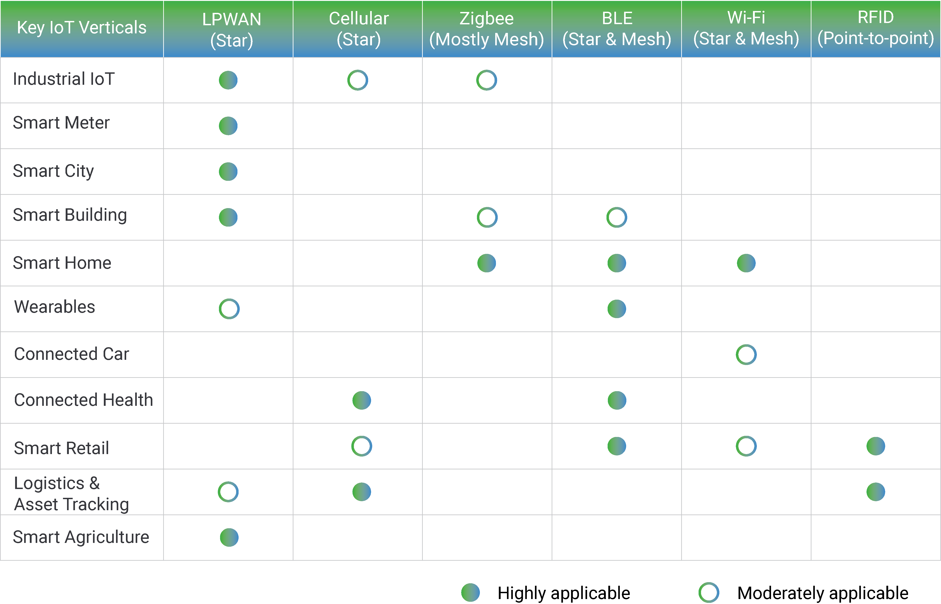
Physical and Link Layers Protocols- use cases
* https://behrtech.com/blog/6-leading-types-of-iot-wireless-tech-and-their-best-use-cases/
Notes:
The frequency range used for today’s PLC solutions starts as low as 125 Hz and reaches as high as 100 MHz. A useful classification of PLC systems is according to frequency bands.
ultra-narrowband (UNB) operating between about 125–3000 Hz,
narrowband (NB) operating between about 3–500 kHz , and
broadband (BB) operating between about 1.8–100 MHz

